Slide 1
GROUP CHAT APPLICATION
Submitted in the partial fulfillment for the award of the degree of
BACHELOR OF ENGINEERING
IN
IBM-BIG DATA
Submitted by:
Digvijay Kumar
19BCS3878
Avinash Raj
19BCS3899
Under the Supervision of:
Mr. Rajiv Kumar
Department of AIT-CSE
DISCOVER . LEARN . EMPOWER

Slide 2
Outline
Introduction to Project
Problem Formulation
Objectives of the work
Methodology used
Results and Outputs
Conclusion
Future Scope
References

Slide 3
Introduction to Project
The application is based on a single server with multiple clients system and it is a desktop-based application for developing frames we will use Java Swing and for communication between server and client we will use socket program a concept of java programming

Slide 4
Problem Formulation
Now, a day's people are heavily dependent on the internet for many purposes and communication is one of the main reasons.
SO, this app provides a platform where anyone can share information from one to other.
Also, this app is a basic app so, there is no sharing of personal data of the user for advertisement purposes.

Slide 5
Objectives
Our main objective for making this project is to solve the above problems mentions so that people can easily text each other. We did not make a big platform for using we just try to use socket programming through we able to connect our server and multiple clients. So that people set a pot number in the server and connect with their system with client start.

Slide 6
Methodology used
The following methodology will be followed to achieve the objectives defined for proposed research work:
1. Detailed study of java swing, socket programming and multi threading.
2. Implementation of multi threading and multicast socket.
3. Use of window builder SWT ( standard widget toolkit) designer

Slide 7
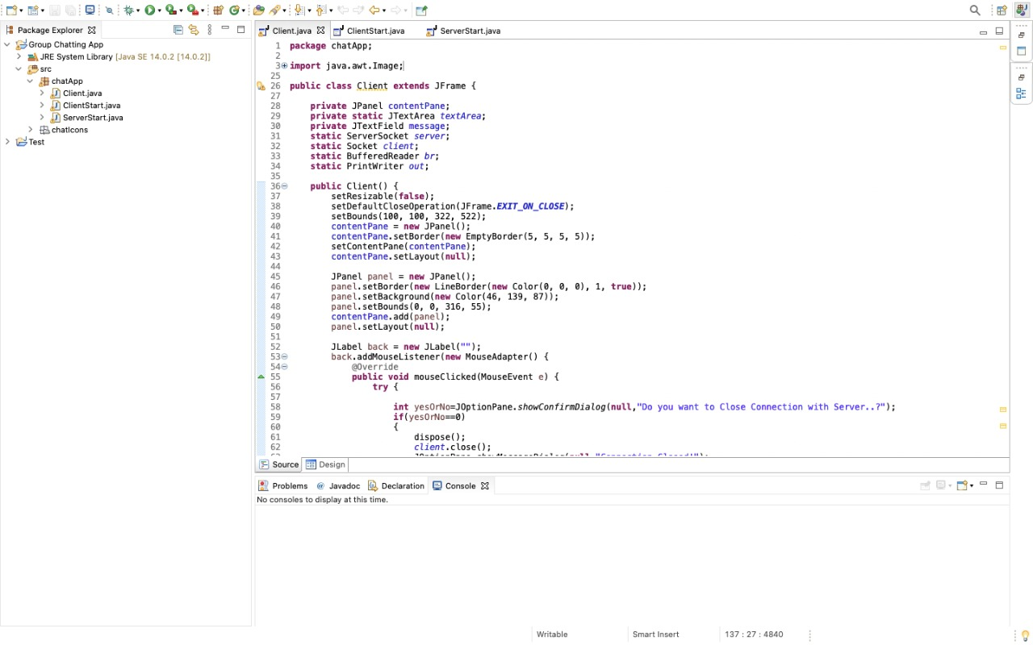
Results and Outputs:
This is the IDE

Slide 8
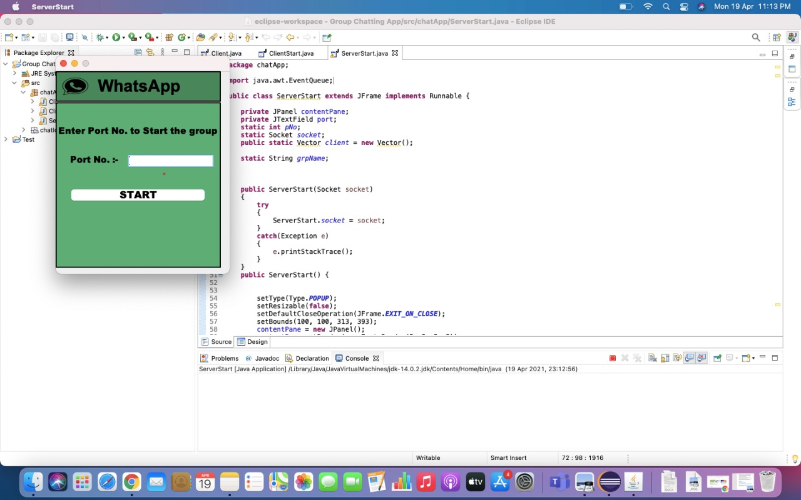
Here we have to enter the port number to start the server on that port

Slide 9

Port number is entered:

Slide 10
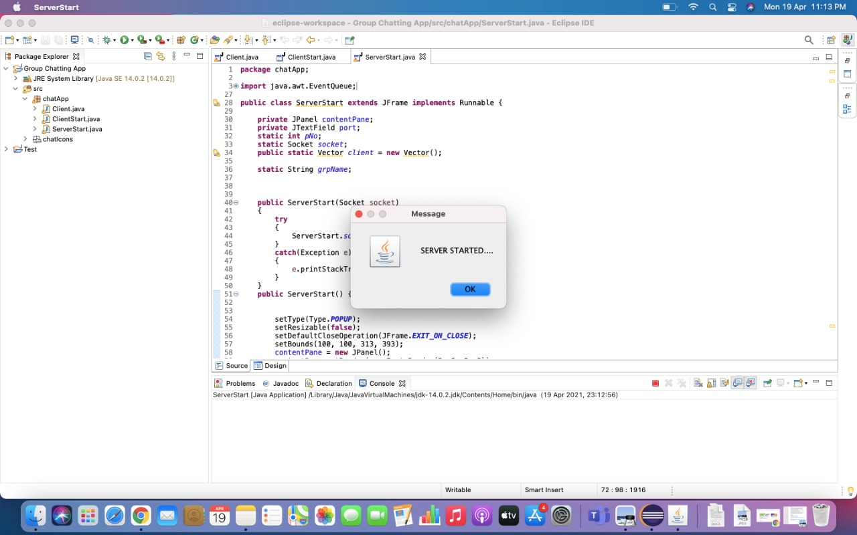
Server Started

Slide 11
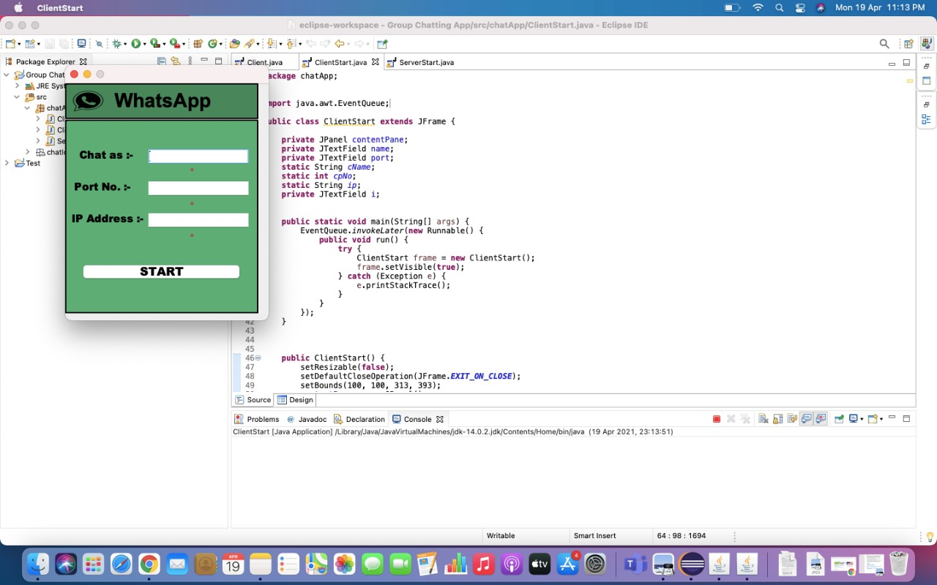
Let’s start the client multiple time because we want to run all our clients in the same system

Slide 12

Here for starting the client we have to enter the port no on which it is to be connected and the IP address of the client.

Slide 13
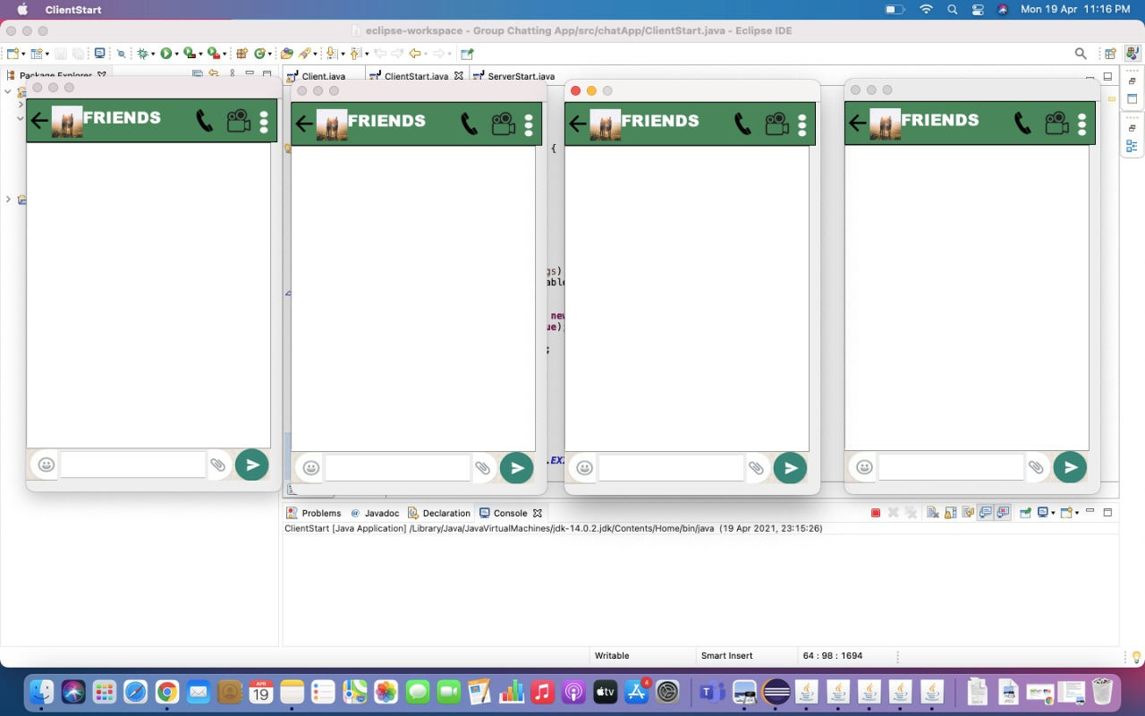
Here we run all our client

Slide 14
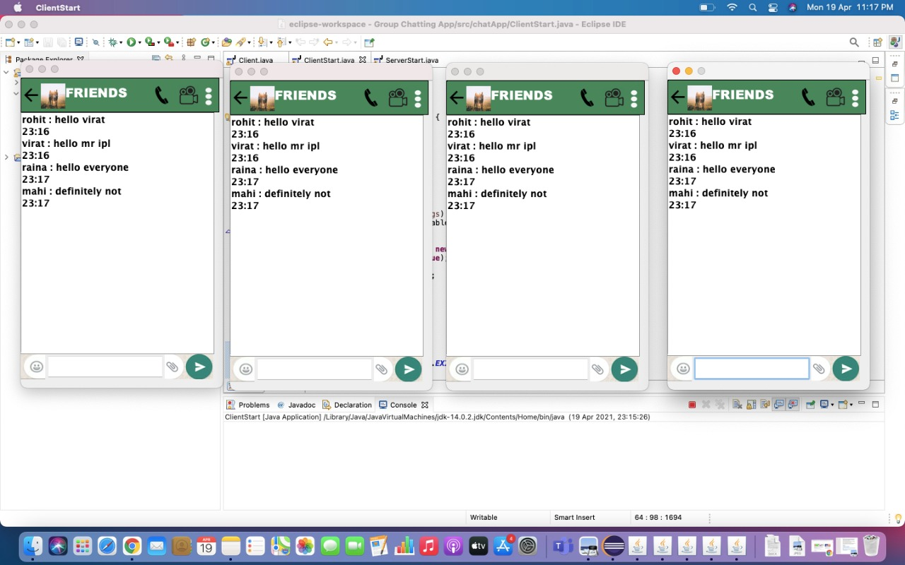
Here we text to each other

Slide 15
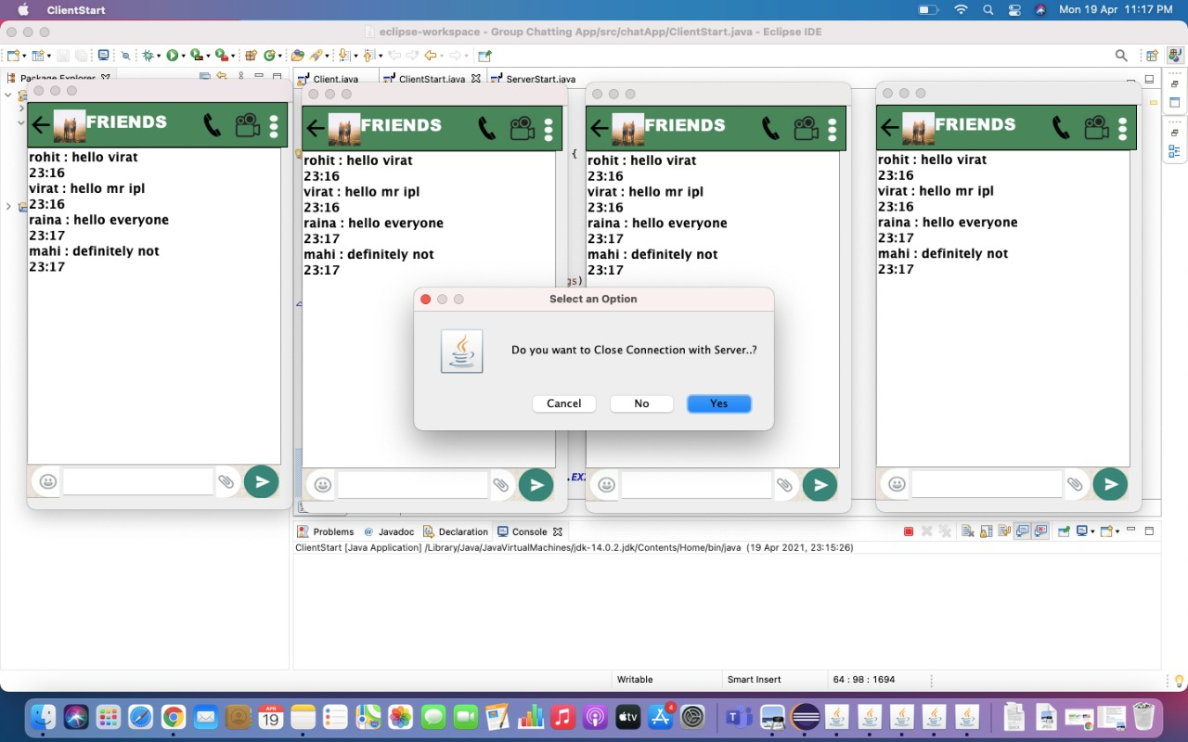
Now we can close the chatting box

Slide 16
Conclusion
First we give the introduction of our project in which we talk about problem definition, project overview/specification, hardware and software specification.
And its also include the literature survey and review of our project. What are problems and implementation.
This report also provide instruction of the concept which is important to understand.
This report will cover what are the methodology for this project and what are the objectives for this project and last it cover the conclusion and discussion

Slide 17
Future Scope
Well polished desktop/mobile app can be made which can be more easier to use.
Other types of data like image ,audio,videos etc can be shared using this
More minimal looking UI can be added to look better

Slide 18
References
1. https://www.javatpoint.com/java-swing
2. https://www.javatpoint.com/multithreading-in-java
3.https://docs.oracle.com/javase/7/docs/api/javax/swing/package-summary.html
4. https://www.vogella.com/tutorials/EclipseWindowBuilder/article.html
5. https://www.eclipse.org/windowbuilder/ #:~:text=WindowBuilder%20is%20composed%20of%20SWT,will%20be%20gene rated%20for%20you

